Slide 1
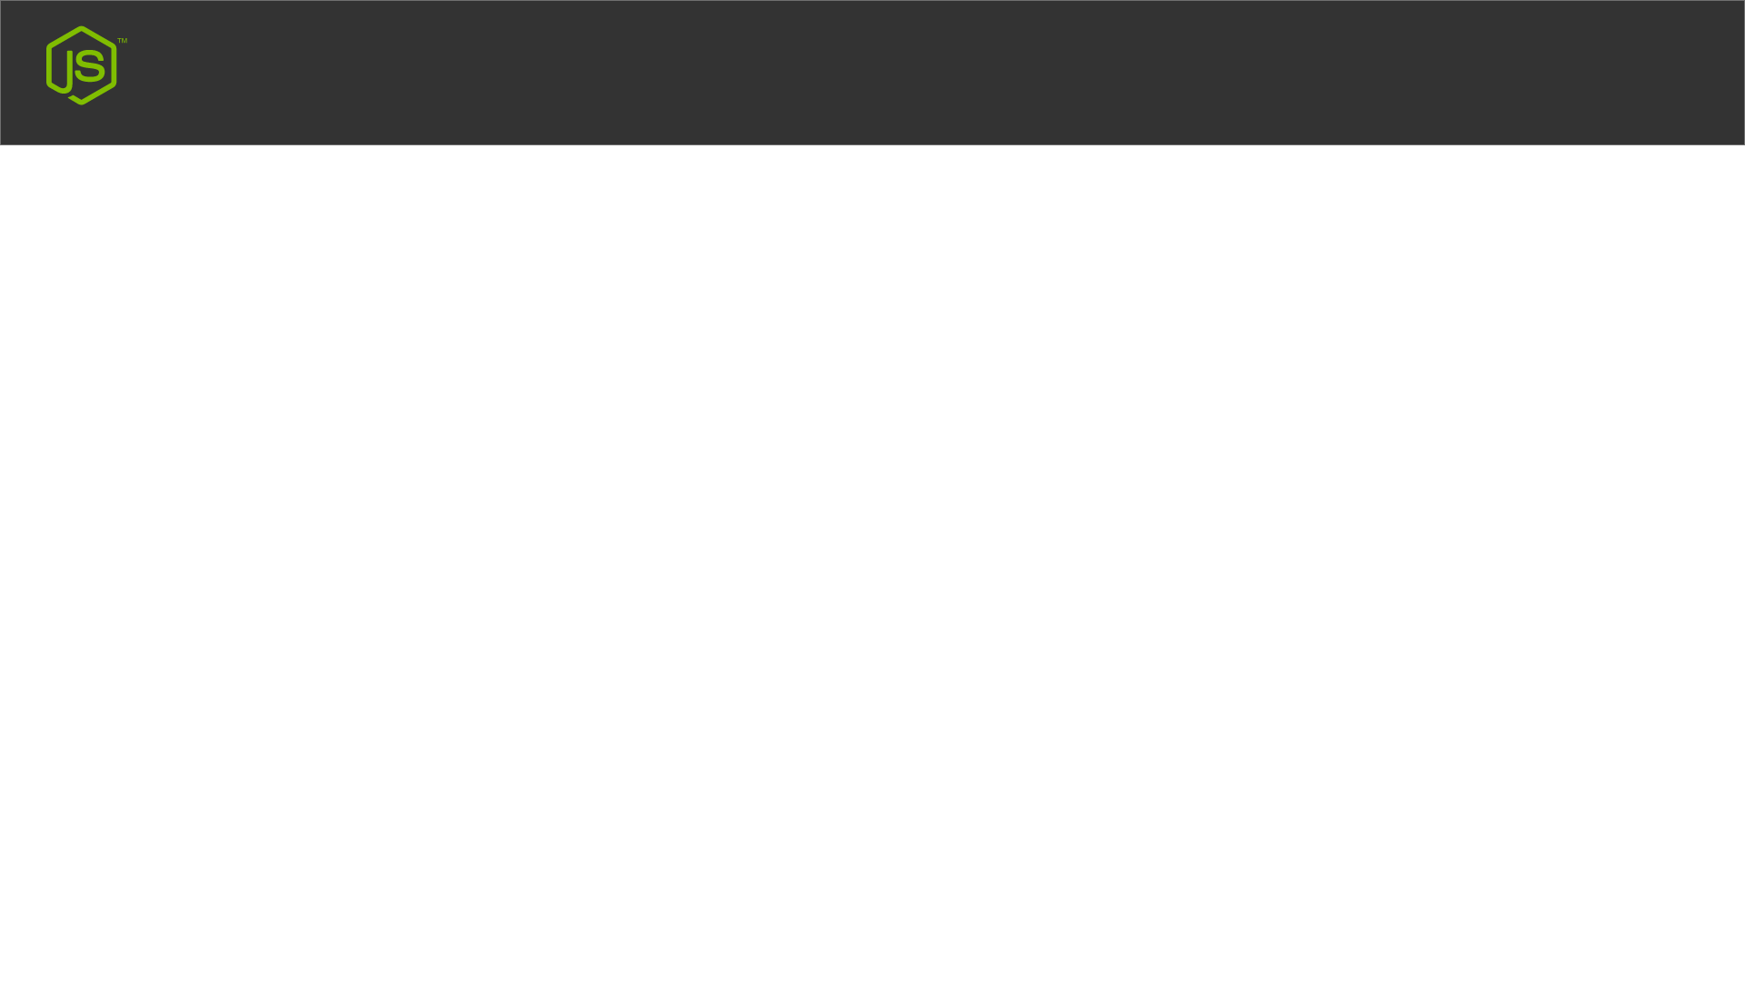
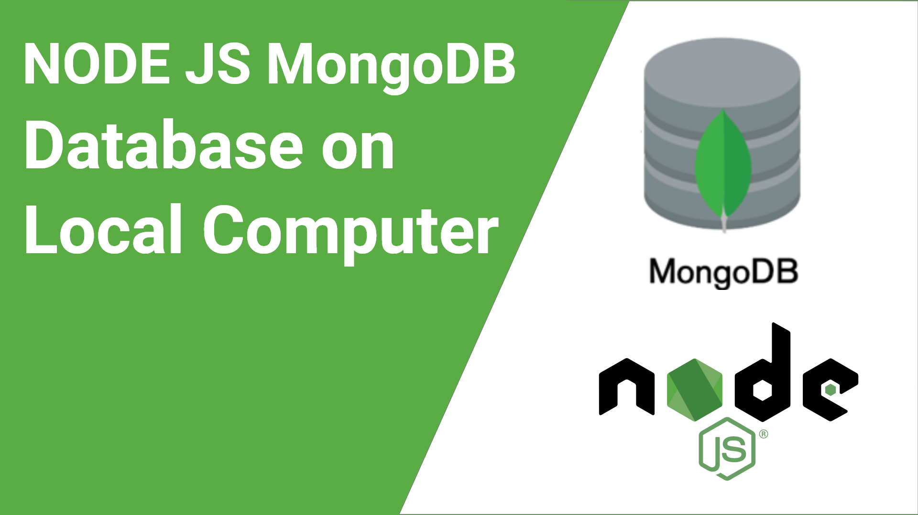
Node JS With MongoDB

Slide 2
Mongo DB On RDP VPS Server Computer

